Slide 1
BITCOIN PRICE PREDICTION & TREND ANALYSIS
INFO 6105 – Prof. Handan Liu
Team 21:
Adina Nibijiang – 001549008
Kartheek Dabbiru - 001575541

Slide 2
Introduction
Bitcoin is a digital cryptocurrency
Generated and stored virtually through specific mathematical calculations
digital encrypted currency with peer-to-peer (P2P) transmissions
world's first and the most successful blockchain application

Slide 3
Goals
01
Analyze and predict the price of Bitcoin
Analysis & Prediction
02
Provide investment advise
03
Understand the future trends of BTC

Slide 4
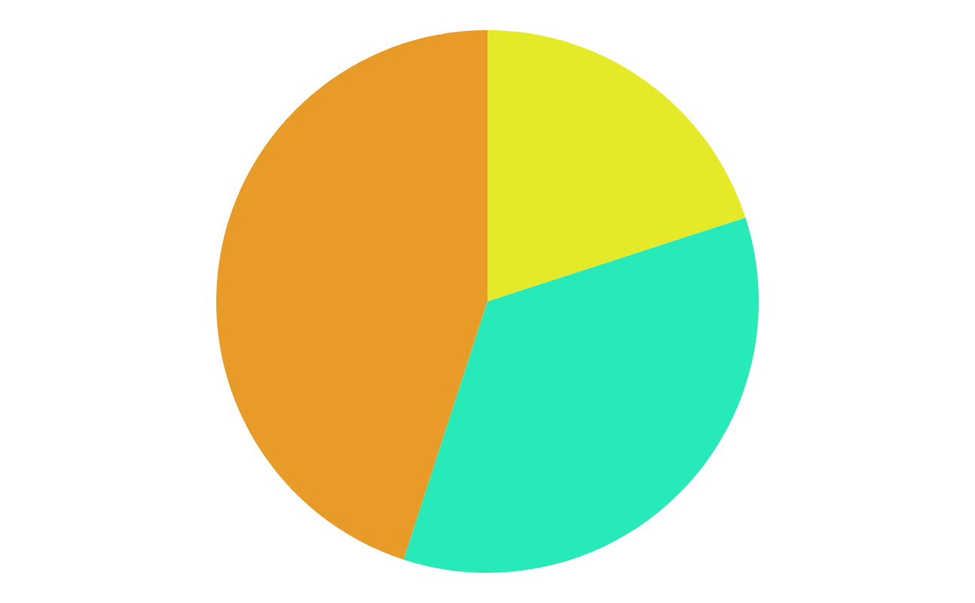
Data Set Description
Historical data of bitcoin between 01/2012 & 03/2021
Time Stamp | Date in Epoch Unix format
Open | Initial currency trading value in that measurement range
High | Highest value reached by the asset during that measurement time
Low | Lowest value reached by the asset during that measurement time
Close | Value of the asset at the time of closing the measurement range
Volume_(BTC) | Volume in BTC, traded on Bitstamp during a given measurement range
Volume_(currency) | Volume in USD, traded on Bitstamp during a given measurement range
Weighted_Price | Average asset price during a measurement range

Slide 5
Implementation
01 | Preparation of Data
 | Cleaning the data and preparing it for analysis
02 | Exploratory Data Analysis
 | Developing statistics and plots to find key features to engineer with
03 | Feature Engineering
 | Extracting relevant information to create an interpretable model
04 | Model Selection & Training
 | Train the best performing model possible using the pre-processed data
05 | Model Evaluation
 | Comparing model scores and metrics to decide which model is accurate

Slide 6
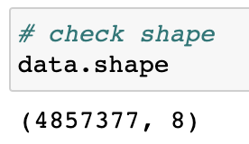
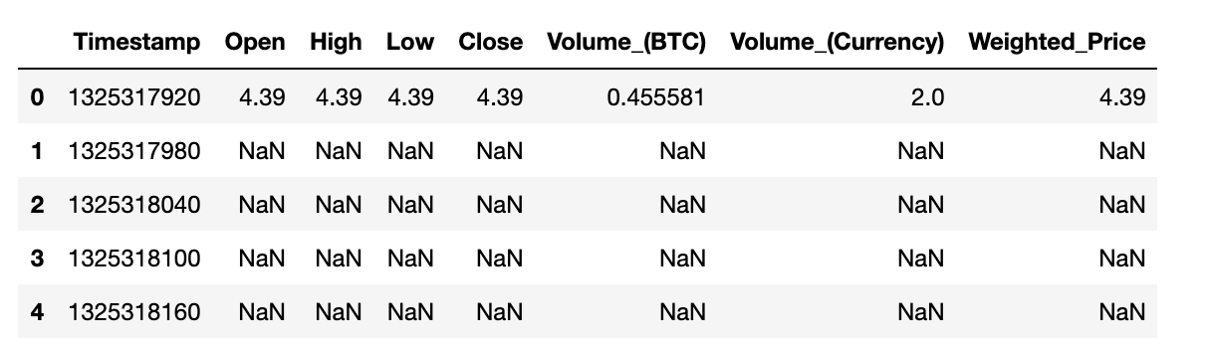
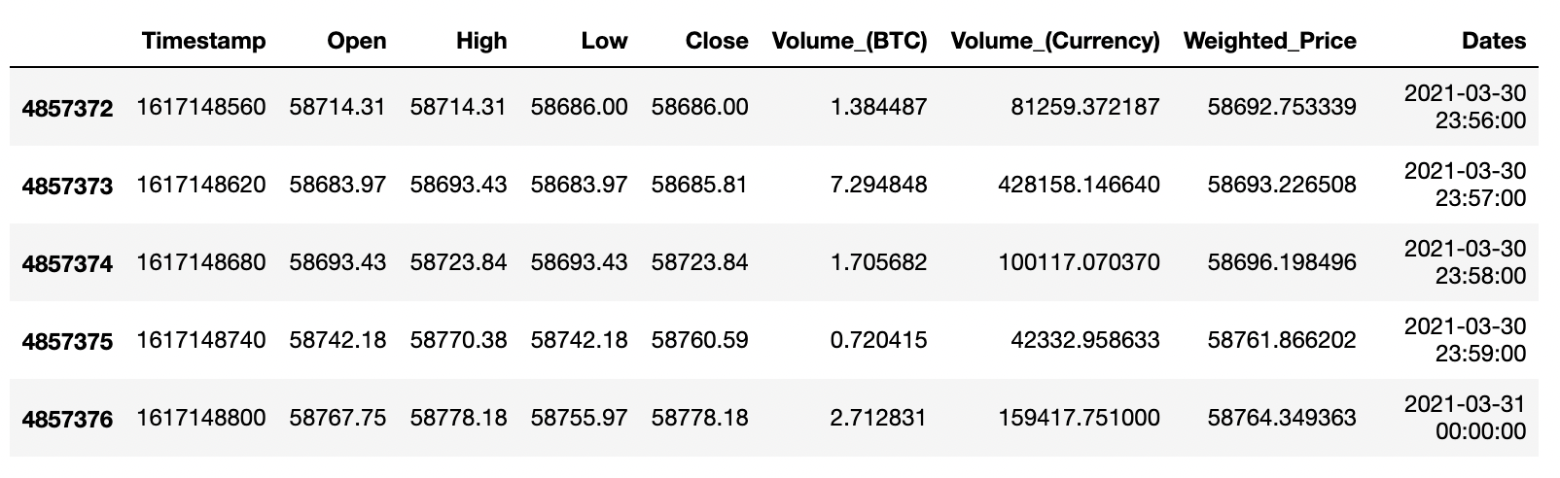
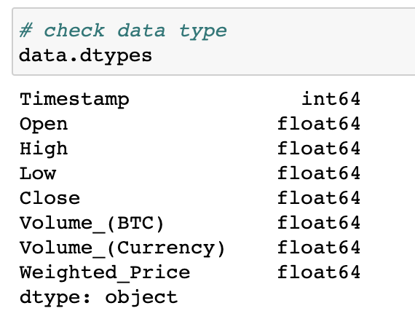
Preparation of Data
Importing the data
Checking data records
Adding new column ‘Dates’
First things first, checking if the data is imported correctly
Then we check for the shape and column datatypes
Converting the timestamp from Epoch Unix format to readable date and time format
After these steps we then removed the records with NA values to obtain better results while training the data

Slide 7
Exploratory Data Analysis
It is an open-ended process where we develop statistics and figures to find a trend or relationship with the data
These findings, information can help us to know what features we can choose in our model
Following are some of the inferred data visualizations after EDA

Slide 8
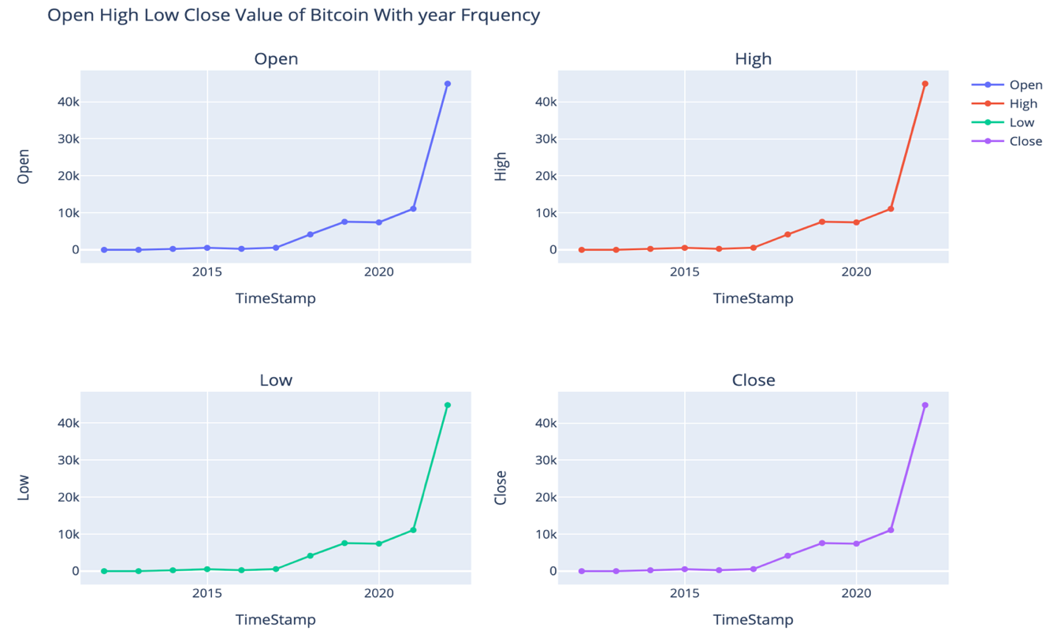
Exploratory Data Analysis (Cont.)

Slide 9
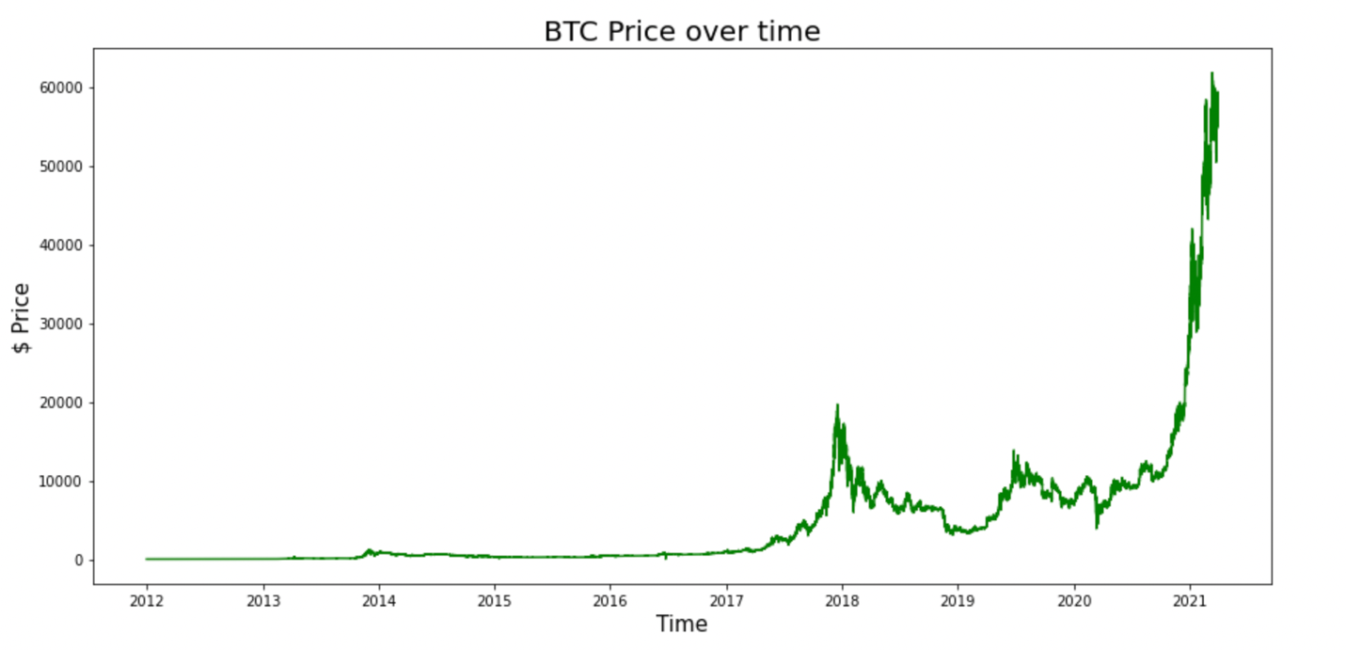
Exploratory Data Analysis (Cont.)

Slide 10
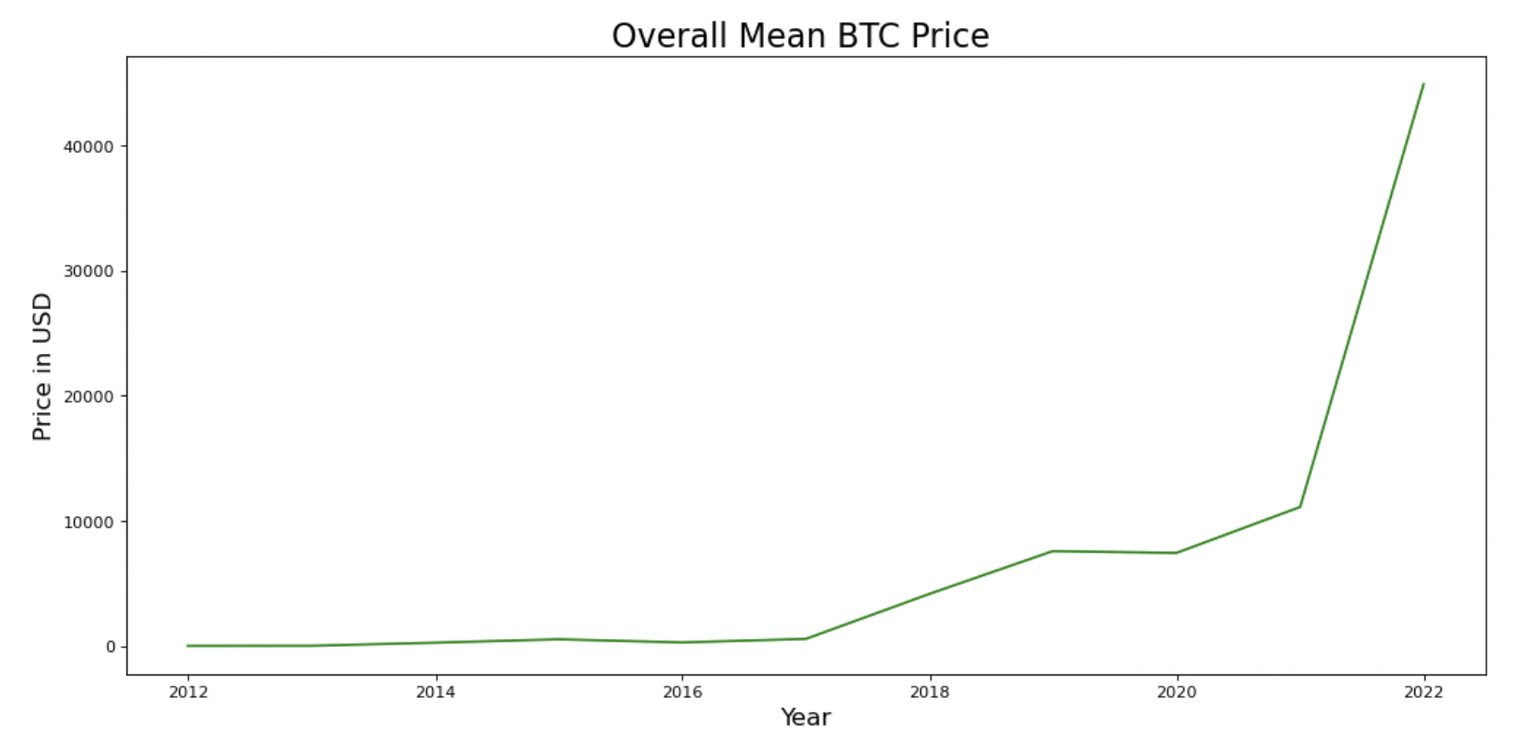
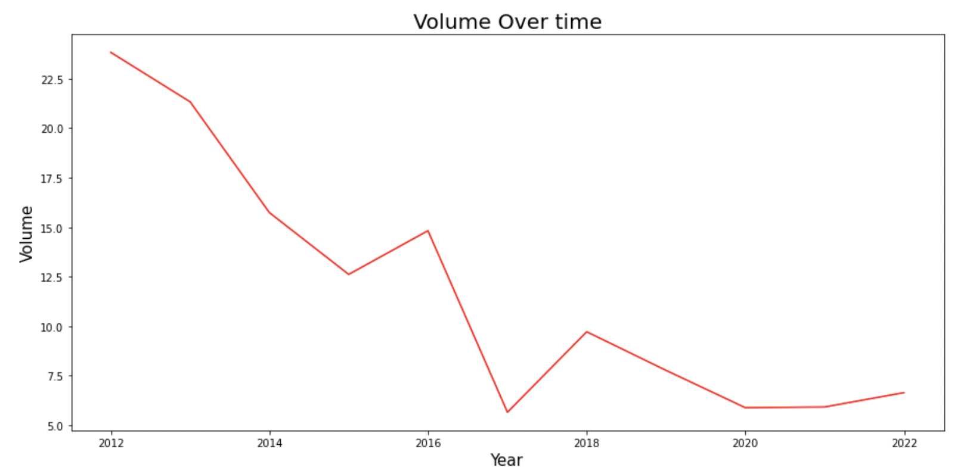
Exploratory Data Analysis (Cont.)

Slide 11
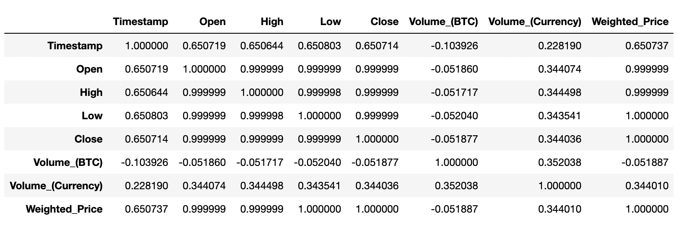
Feature Engineering
process of taking raw data and choosing or extracting the most relevant features
Helps us to omit the unwanted features and create a more interpretable model
We then use Dataframe corr() method to find out to what extent these features are correlated

Slide 12
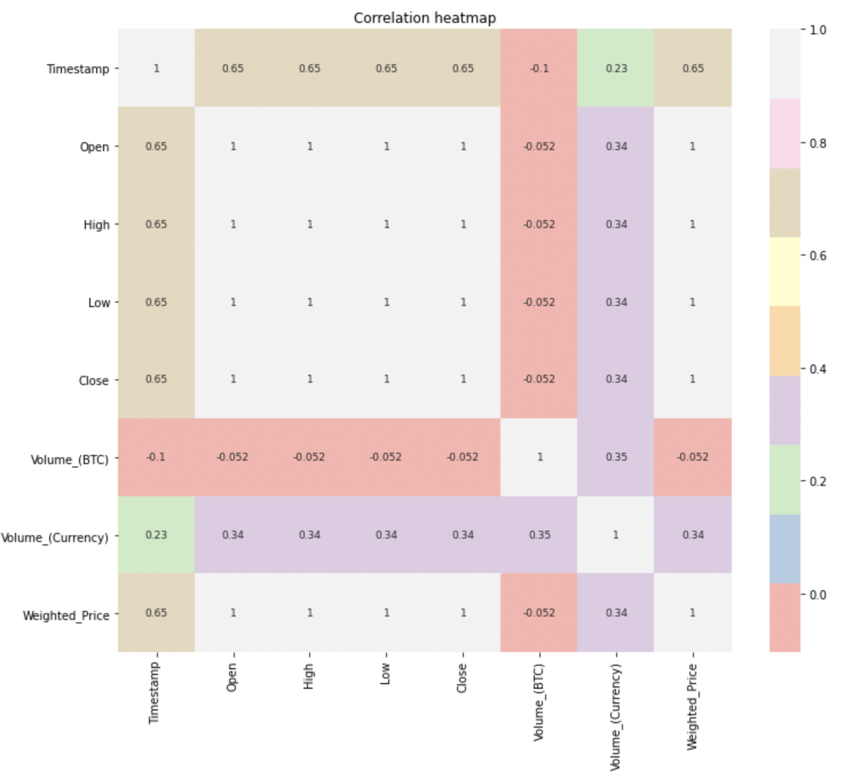
Feature Engineering (Cont.)
To better understand the correlation matrix, here is the heat map of correlation martrix

Slide 13
Model Selection & Training
01
Linear Regression Model
Problem of Regression
After processing and analyzing the data, predicting BTC price can be understood as a problem that can be solved using regression algorithms
02
Random Forest Regressor

Slide 14
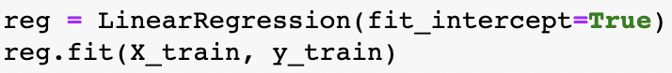
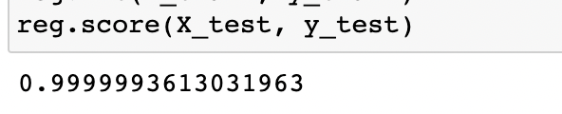
Linear Regression Model
First, we train the model by linear regression and predict the price for 300 days.
We then calculate the score of the linear regression model to see how the model performs on the test data.

Slide 15
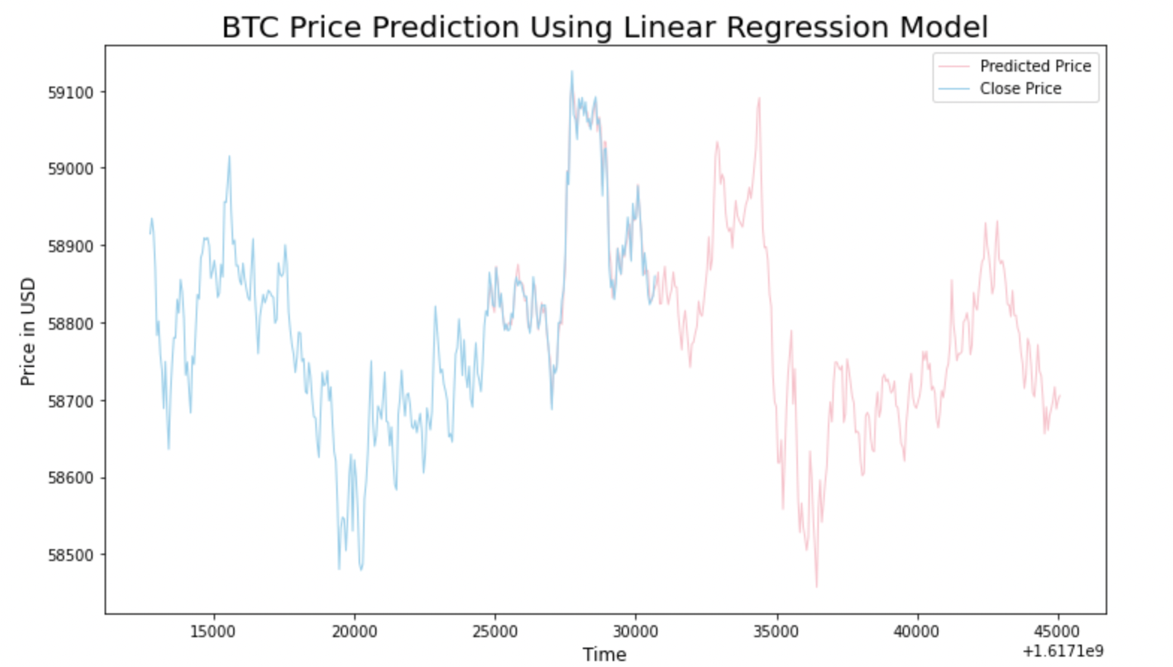
Linear Regression Model (Cont.)
Since this dataset’s end record date is in March 2021, so we decide to predict price by shifting original dataset for 300 days.

Slide 16
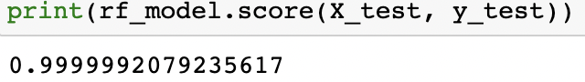
Random Forest Regressor
First, we train the model by Random Forest regression and predict the price for 300 days.
We then calculate the score of the Random Forest regression model to see how the model performs on the test data.

Slide 17
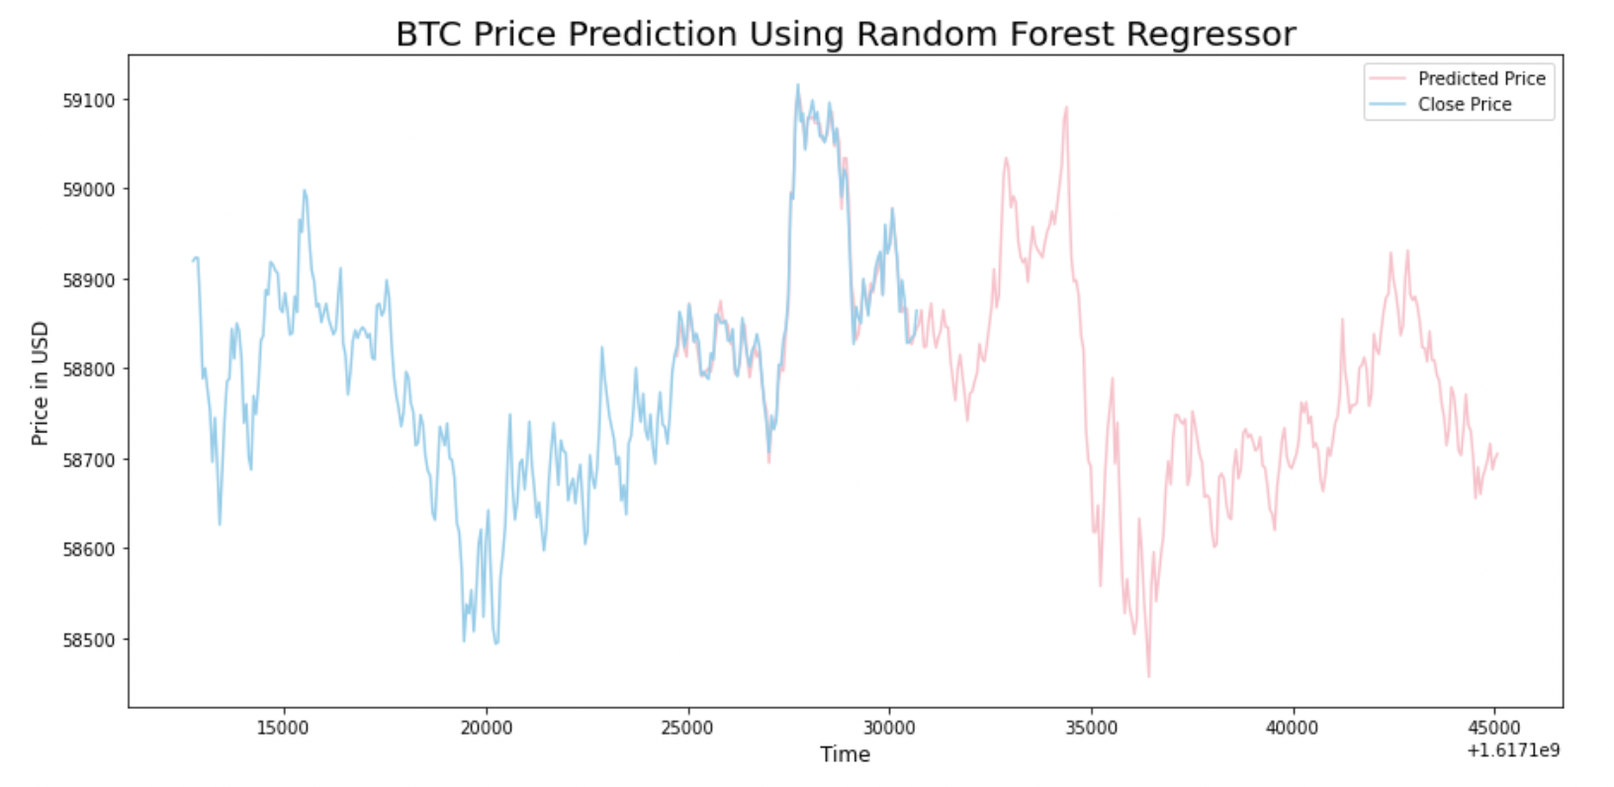
Random Forest Regressor (Cont.)
Here is the plot we gain showing the previous Bitcoin prices and our predicted prices, in blue and pink. Blue representing the price from the existing data and Pink representing the predicted price.

Slide 18
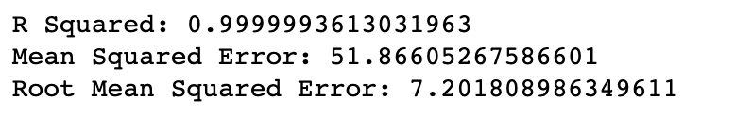
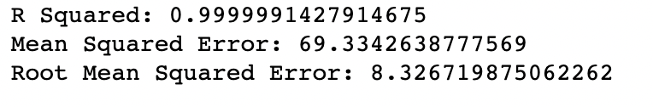
Model Evaluation
Since both the models have a similar score (>0.99), we can compare them again error score metrics, R squared, Mean squared error and Root mean squared error.
Metric scores for Linear Regression model:
Metric scores for Random Forest Regressor:
From these scores we can infer that Linear regression model is slightly better than Random forest regressor in predicting the price of Bitcoin.

Slide 19
THANK YOU!

